Slide 1

Engineering Codex
Governance
d
g
x

Slide 2


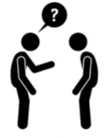

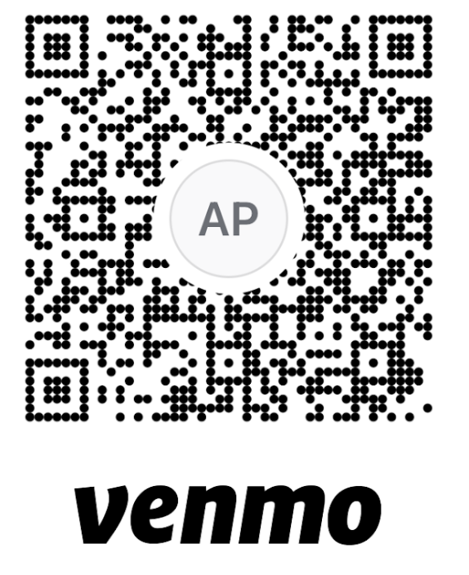
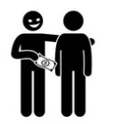


My goal is to empower you, with some actionable knowledge,
and inspire your curiosity
I’m happy to reiterate
any content, just ask.
I can take questions while i’m presenting.
I encourage discussion and active participation,
but please be kind.
To finish earlier...

Slide 3
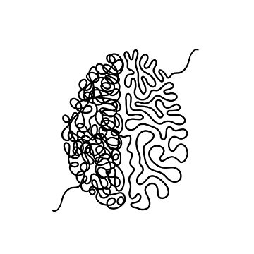
motivated by the allure of agility
motivated by minimization of risk
delivery teams doing what they need, with close to zero governance imposed on them results in a sprawl of tools and processes
hierarchical command and control through dedicated groups has a massive impact on speed of delivery.
Two Failure Modes

Slide 4
Governance is largely concerned with setting the direction an organisation intends to move in, and then verifying that it’s actually doing so.

Slide 5
Move from Mandates to Vision & Principles
Automate and Delegate Compliance
Enlist Gatekeepers as Collaborators
Provide Paved Roads
Radiate Information
Get Comfortable with Evolution
Responsive Governance

Slide 6
Move from Mandates to Principles & Vision
Co-Create Principles: While there’s still benefit in alignment artifacts created by a small leadership group, we’ll get better buy in and adoption when using collaborative approaches to creating and agreeing what the principles should be
Living Artifacts: Treat our agreed upon principles as software delivery artifacts stored in source control
Move from mandating specific tools, protocols and solutions to framing a higher level vision with a set of principles and constraints, which still leaves a good degree of autonomy and creativity on how to fulfil them.
Machine Readable: Leveraging machine readable languages such as Markdown and PlantUML enables team to keep history and track changes standard tools and processes

Slide 7
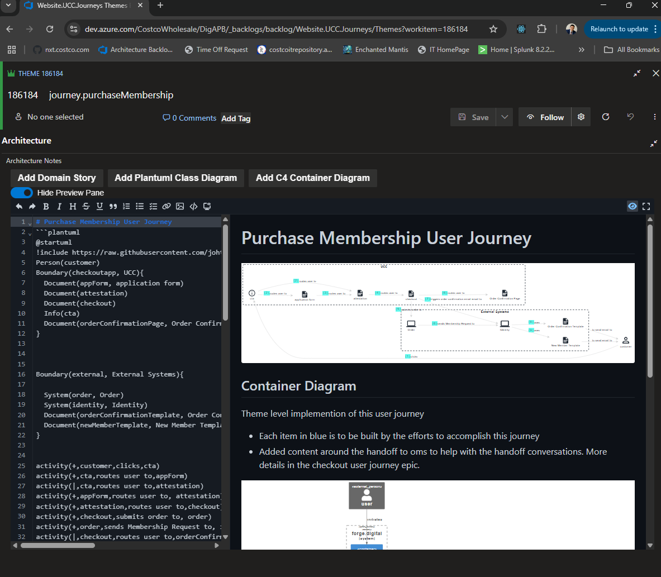
Diagrams in Code in ADO means we have searchable diagrams, that won't get lost, and which we can review an update in sprint ceremonies if we need to.
Diagrams as Code in Backlog

Slide 8
Automate & Delegate Compliance
Automate & Delegate Compliance: Make use of automated software delivery practices to switch from having to objectively determine what good looks like, to being able to measure what is within bounds.
Build Time Compliance: Using source control we can automatically and comprehensively track all changes made to critical infrastructure. Artifact repositories give us the ability to store architectural decision records or change control artefacts.
Shifting left to incorporate moving governance activities into the delivery process has a number of major upsides — it means that we can now start to treat governance and compliance activities as elements of software delivery and their outputs as software artifacts
Run Time Compliance: Building in the right level of observability enables us to define architectural fitness functions for our platform. Programmable infrastructure gives teams the ability to monitor and define thresholds, configure alerts and escalation and maintain these configurations as software assets.

Slide 9
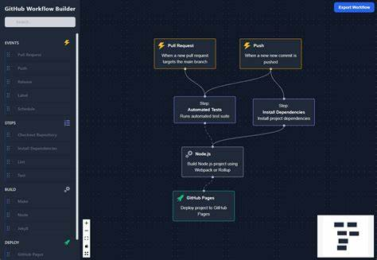
Github workflows can help us automate our governance
Source Controlled Based Governance Automation

Slide 10
Enlist Gatekeepers as Collaborators
Evangelism and Workshops: This leads to better two-way learning, and also can be a good connection point for spotting good ideas or tools to reuse elsewhere.
Automation: Using automation frees up capacity. Scarce, specialised skills should be put to use to solve the hard problems as opposed to spending time policing or ticking off checklists as approval activities move from evaluation of individual instances towards overall approaches or patterns
An architecture team as a group of gatekeepers who issue opaque mandates, is an antiquated idea. A better approach is to use the group as consultants, coaches and advisors for teams, that get engaged early on in the process. They can be articulating the organisational principles and constraints, but should also be helping teams figure out how to meet them.
Assurance as Capability Building: It’s unlikely that the oversight role of gatekeepers completely goes away over time, though one of their main objectives should be to decrease the amount of assurance required as automation and expert assistance increases.

Slide 11
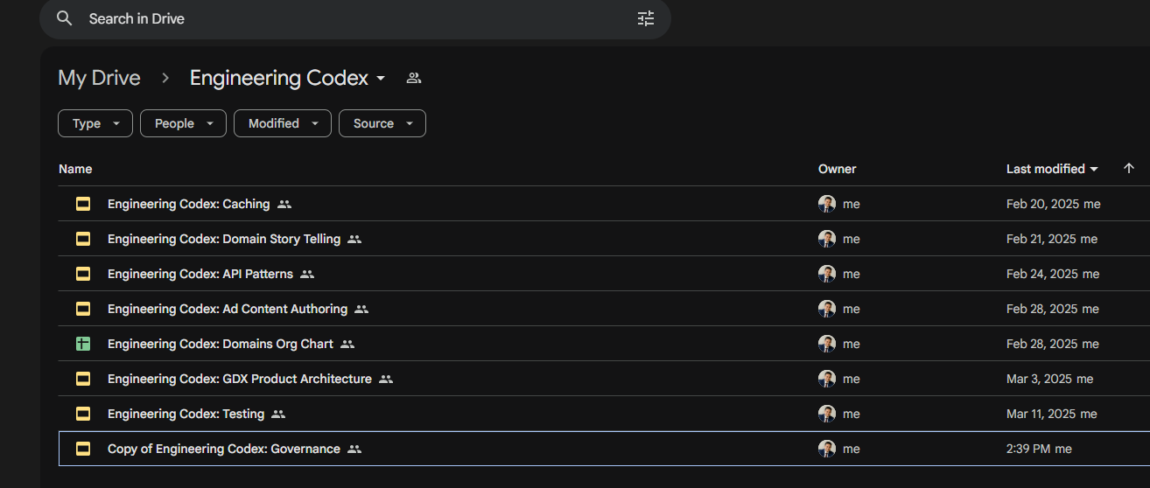
The Engineering Codex Series is a library of decks that have been co-created with various teams, to form an opinion on a GDX Paved Road
Engineering Codex

Slide 12
Provide Paved Roads
Digital Platform: “A digital platform is a set of APIs, tools, services, organisational structures and operating model that are arranged as a compelling internal product and allow autonomous teams to deliver digital solutions quickly and at scale”
Pit of Success: The idea of the GDX platform is to make doing the right thing easy. The devX for teams makes it trivial to operate within risk tolerance, comply with architectural principles and regulatory guidelines or standards.
Netflix has been credited to have coined the term “paved road” — a set of centrally supported tools that are offered as platform-as-a-service offering to their internal delivery teams. These tools may include helper libraries, service templates, build and deployment tooling, pipeline configurations or even a managed container orchestration service based on standard tooling like Kubernetes
Products: Walking on the paved road is optional. If a team feels the need the take a different path, then we have to re-evaluate the value proposition of our platform. Treating our platform as a first class product in our portfolio forces governance checks on it, from its users.

Slide 13
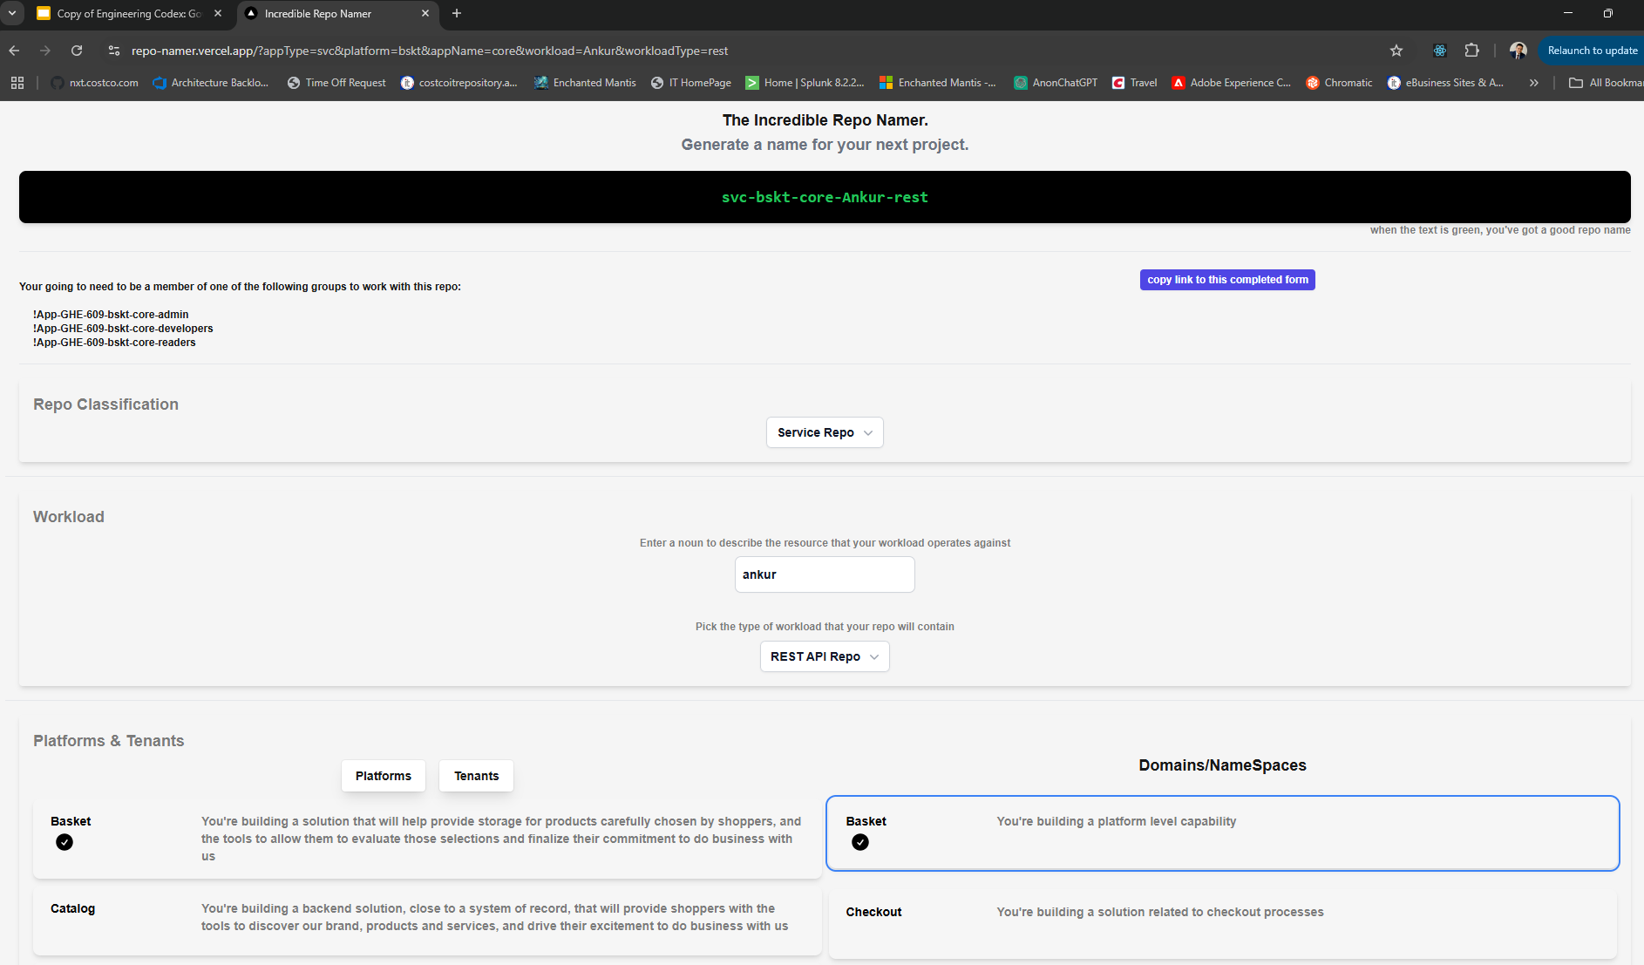
Development Tools like the Incredible Repo Namer make it easier to do the right thing
Incredible Repo Namer

Slide 14
Radiate Information
North-South: north-south is how strategy and direction flows down to teams, and how the realities on the ground flow back up to direction-setters
East-West: east-west is how teams share their lessons, discoveries and innovations to other teams and groups in the organisation.
TechRadar: Generating an internal Techradar can be a catalyst for architectural conversations, decision making and as an information radiator. Updated on a regular basis, this will give visibility across teams about what tools and techniques are currently being trailed, assessed or discontinued.
In this way the tech radar radiates as both an east-west sharing opportunity and as a north-south opportunity to get visibility and impose direction
Objectives and budgets flow down, status reports flow up.
Dynamic governance challenges this model to the point where we rethink our communication patterns to ensure each communication is radiating in all directions

Slide 15
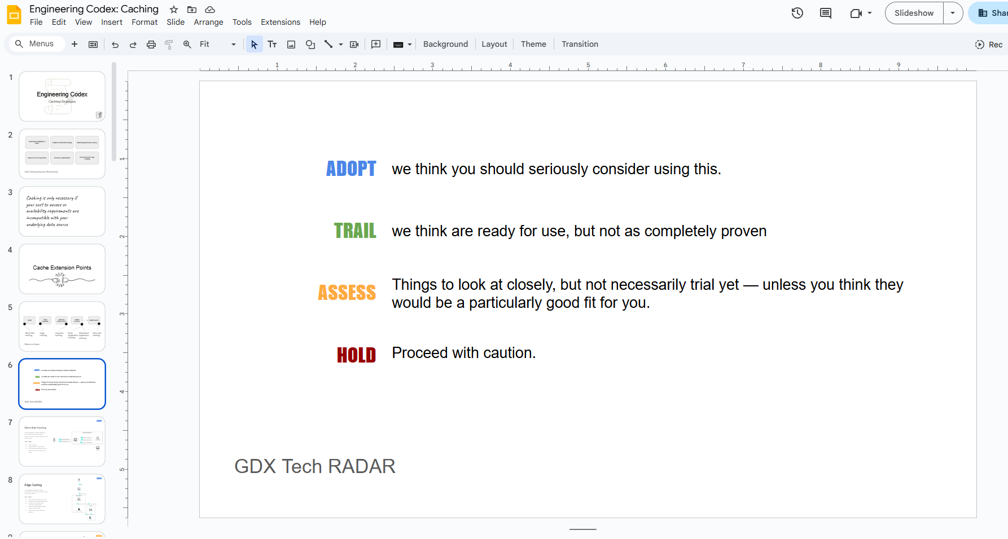
A Tech Radar solution is something we should invest in to radiate information
Tech Radar

Slide 16
Get Comfortable with Evolution
Department of No!: This is the traditional approach to governance at Costco. It is a result of decision keepers being several steps removed from the teams actually doing the work
Have a Conversation: Rather than performing a formal review, we should be striving to collaborate, with a goal of sharing and aligning, against organizational momentum
Start Simple: Complex systems arise from simple systems, and they have to be exercised in the wild to grow. Incremental or iterative paths towards delivery are key to successfully launching our products. Such delivery requires a lightweight and responsive governance that accounts for the needs to today, but is grounded on the vision for the future.
Comfort with evolution will be necessary to embrace the new reality of your systems being in a constant state of flux.
Many of review groups are accustomed to seeing very polished "end state" diagrams (which may or may not bear any relationship to what the end state ends up looking like). Getting them comfortable with how architectures evolve, and what they should be caring about when, is a big learning curve.

